Slide 1
Globalizing K-Pop project- Sentiment Analysis
Prepared by:
Aditi, Gunpreet, Krish

Slide 2
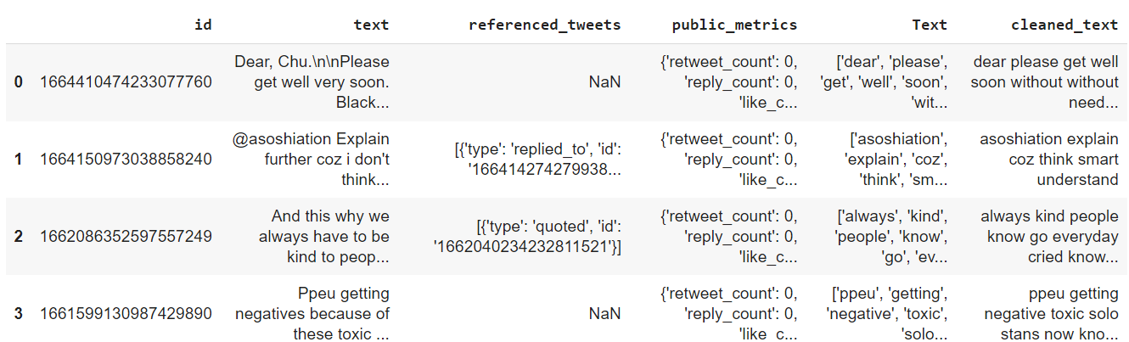
Dataset Preview
Data Size(After filtering): 2773 rows

Slide 3
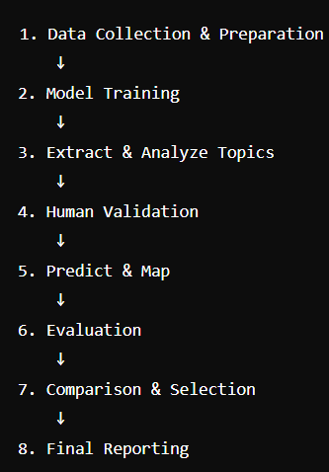
WORKFLOW of Project

Slide 4
Evaluation:
Quantitative Evaluation:
Coherence Score: Calculate for all models.
Perplexity: Calculate for LDA.
Reconstruction Error: Calculate for NMF.
Singular Values Analysis: For LSA.
Qualitative Evaluation:
Visualize topic distribution (pyLDAvis for LDA).
Compare predicted categories with human categorization.
Calculate accuracy, precision, recall, and F1-score.

Slide 5
Evaluation
Fandom | Model | Coherence Score
BlackPink(n= 5) | LDA | 0.661
BlackPink(n= 5) | NMF | 0.450
BlackPink(n= 5) | LSA | 0.409
BlackPink(n= 4) | LDA | 0.658
BlackPink(n= 4) | NMF | 0.472
BlackPink(n= 4) | LSA | 0.28
Fandom | Model | Coherence Score
Sf9(n= 5) | LDA | 0.574
Sf9(n= 5) | NMF | 0.545
Sf9(n= 5) | LSA | 0.42
Sf9(n= 4) | LDA | 0.567
Sf9(n= 4) | NMF | 0.402
Sf9(n= 4) | LSA | 0.393
Fandom | Model | Coherence Score
BTS(n= 5) | LDA | 0.637
BTS(n= 5) | NMF | 0.450
BTS(n= 5) | LSA | 0.409
BTS(n= 4) | LDA | 0.616
BTS(n= 4) | NMF | 0.472
BTS(n= 4) | LSA | 0.28

Slide 6
Evaluation- LDA
Fandoms | Perplexity
BlackPink(n= 5) | -9.609
BlackPink(n= 4) | -8.942
Sf9(n= 5) | -9.164
Sf9(n= 4) | -8.817
BTS(n= 5) | -9.29
BTS(n= 4) | -8.649

Slide 7
Evaluation- NMF
Fandoms | Reconstruction Error
BlackPink(n= 5) | 7.62%
BlackPink(n= 4) | 7.16%
Sf9(n= 5) | 7.75%
Sf9(n= 4) | 7.73%
BTS(n= 5) | 7.59%
BTS(n= 4) | 7.78%

Slide 8
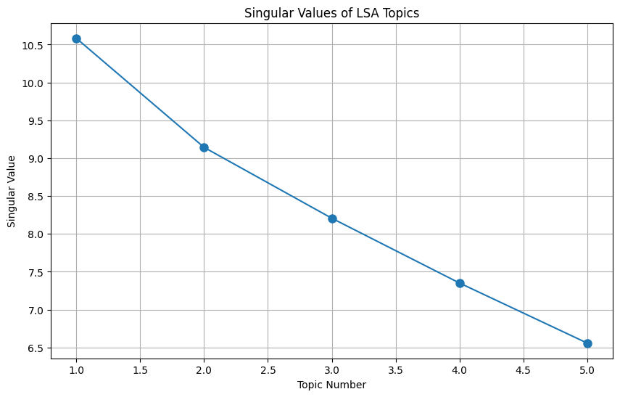
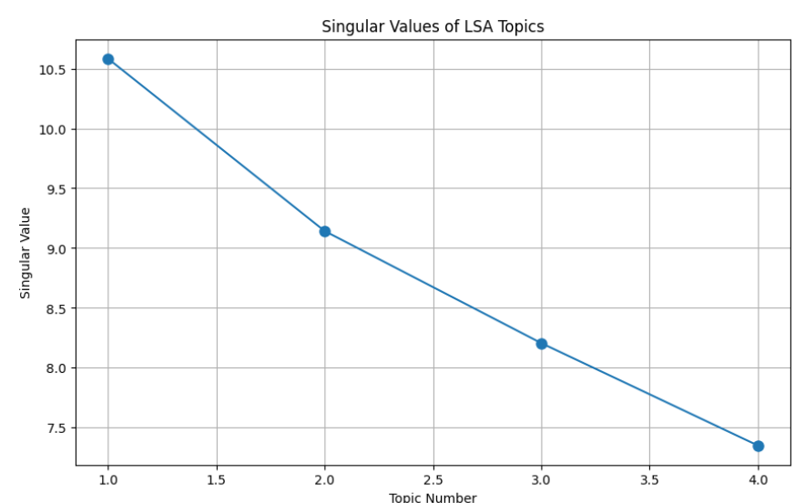
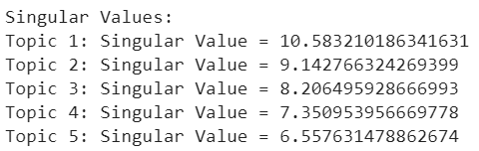
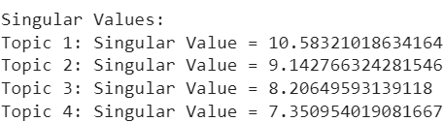
Evaluation- LSA
Singular value analysis

Slide 9
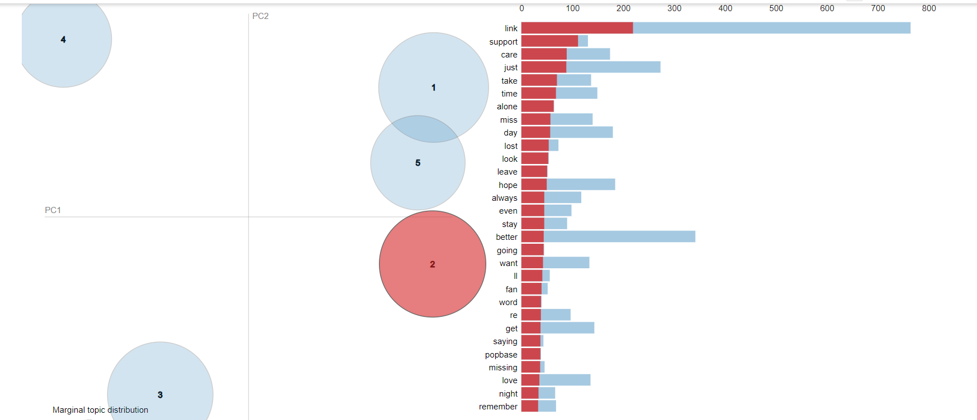
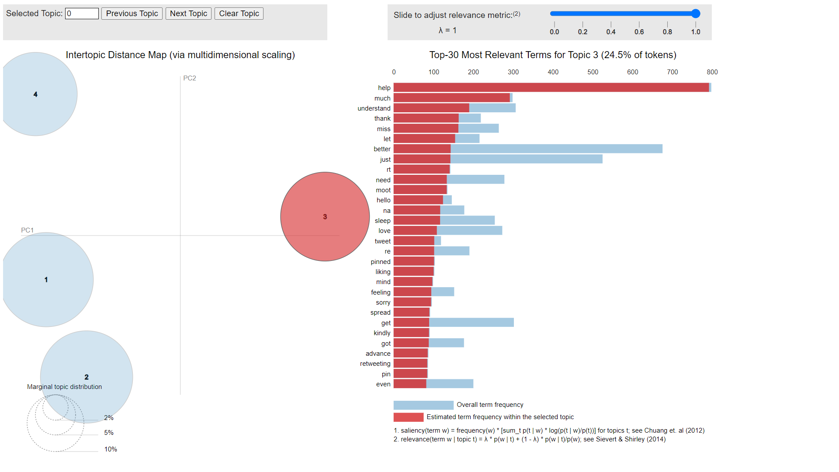
Evaluation(LDA)- BlackPink pyLDAvis Visualization
N=4
N=5

Slide 10
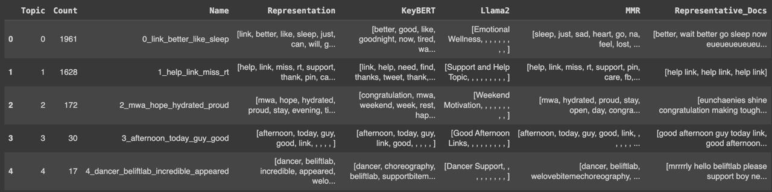
BERTopic model

Slide 11
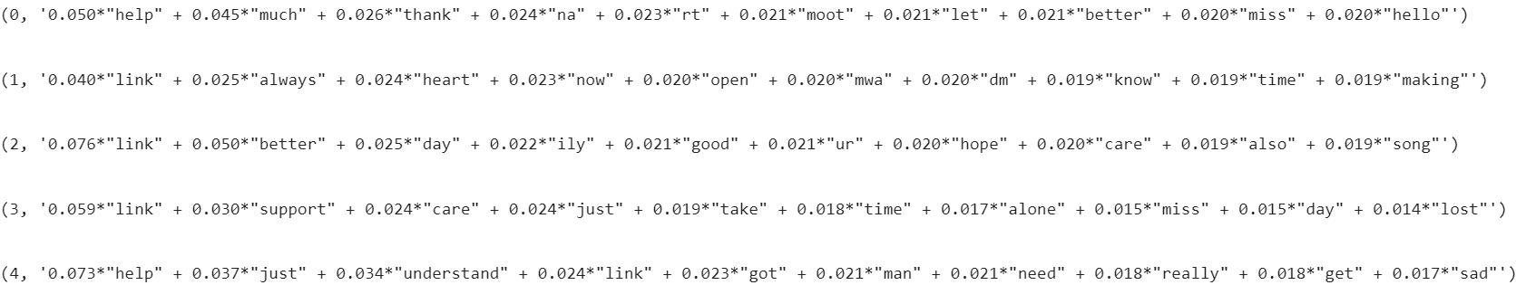
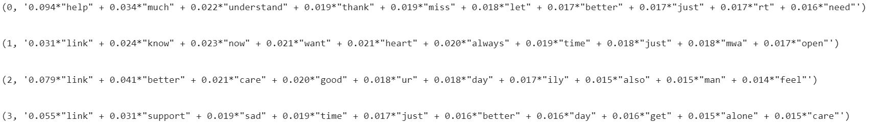
Evaluation- LDA Keywords
https://colab.research.google.com/drive/14MdtIhvV71c9V2XKD5F2O22c0jYS798F?usp=sharing - BTS
N=5
N=4

Slide 12
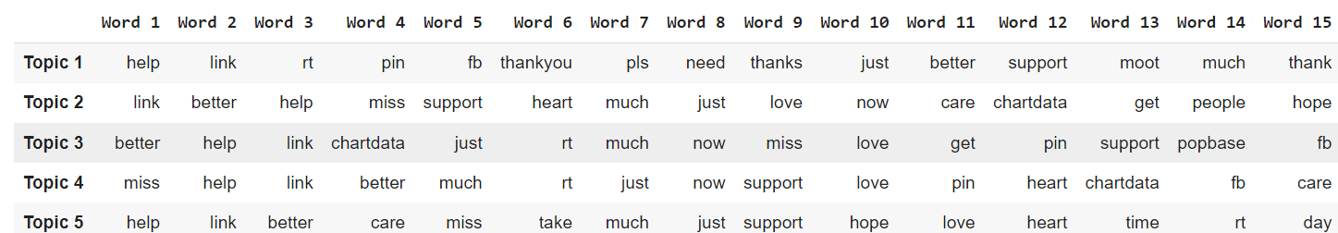
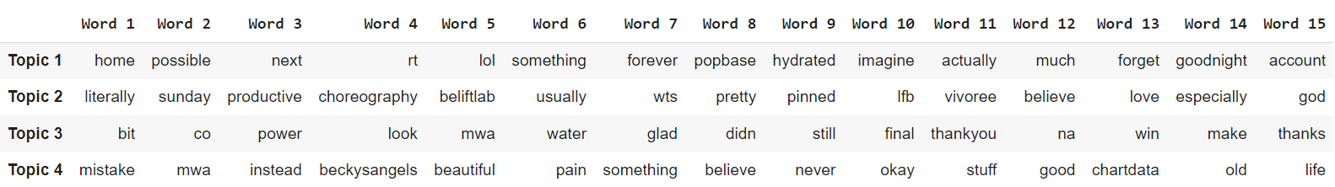
Evaluation- NMF Keywords
https://colab.research.google.com/drive/1Qeuq-AjXTjMIIX2isQrIKrd7OJKEyLkE?usp=sharing- SF9
N=5
N=4

Slide 13
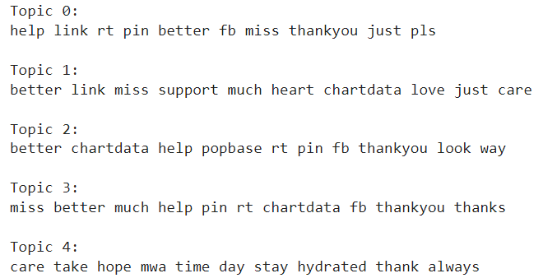
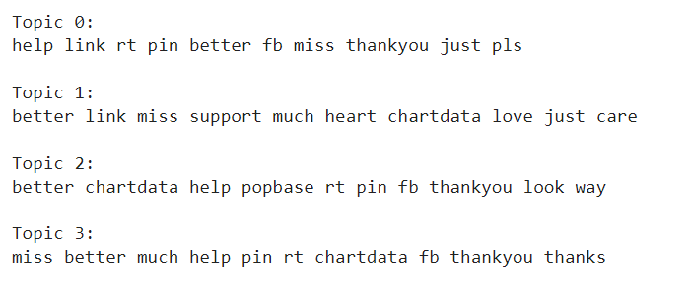
Evaluation- LSA Keywords
N=5
https://colab.research.google.com/drive/1fb44rKdFCvDruEn5B2IqAAjHltEJpt8u?usp=sharing - Blackpink
N=4

Slide 14
Top Documents Analysis for nmf
(Blackpink)
Topic 1: Requests for Help
Top documents for Topic 1:
Document 900: "@BeautylsU help 🕵️‍♀️🕵️‍♀️🕵️‍♀️🕵️‍♀️"
Document 1226: "@winterglocks @gatorexico2 HELP ME"
Document 641: "@lessthancaro HELP"
Document 617: "@abelsinitation HELP"
Document 587: "help why is the amount increasing 😭“
Topic 2: Discussions and Recommendations in The Sims 4 Community
Top documents for Topic 2:
Document 1816: "3/3 💖 #TheSims4 #Sims4 #Sims4CC Patreon : https://t.co/hb3bZ8uztP CurseForge : https://t.co/RwafNKbdX5 Support me : https://t.co/xraFMU4hvl Linktree : https://t.co/VeAYSJFePi 💖💖 https://t.co/9nwzPkH2QR"
Document 1817: "2/2 💜 #TheSims4 #Sims4 #Sims4CC Patreon : https://t.co/xkF5cRP20h CurseForge : https://t.co/pPzI6CXhjr Support me : https://t.co/xraFMU4hvl Linktree : https://t.co/VeAYSJFePi 💜"
Document 1964: "@sooyapaved He is so caring 😔🥺10/10 https://t.co/iBUsnEqrSm"
Document 2758: "this is challenging 😩 https://t.co/1jqcYc5qNf"
Document 1298: "@skywontmiss @Unhinged_Onl1ne @lilycalsss YAY MWAH https://t.co/Sn97dK71Oh“
Topic 3: Comparisons and Opinions on Various Topics
Top documents for Topic 3:
Document 422: "@RealRyanBlox Tastes better than the cupcake, cake, and hippomelon"
Document 253: "@soompi Jisoo is a better actress"
Document 192: "@allkpop Better than shinee & exo"
Document 249: "@soompi abnormal chin but at least better than Rose’s chin"
Document 2120: "@klossestfriend i can do better than this on picsart"
Topic 4: Expressions of Missing Someone or Something
Top documents for Topic 4:
Document 2054: "i miss you winston so bad :("
Document 2745: "@MadMedMed wah i miss this"
Document 2704: "@dubuchocochip OML I MISS YOU 😭😭"
Document 996: "@allybools ALLYYYY. I MISS YOU😭💖"
Document 2701: "@achiraa__ Bread + cookie ! Miss u achii“
Topic 5: Care and Well-Wishes
Top documents for Topic 5:
Document 2680: "@iluvjoyers_ Gm, take care Joy!"
Document 402: "@kamisatokisser seriously alhaitham's typa guy to take care of kaveh when he's over stressed 😭"
Document 2673: "@fourthin14 Take care!!"
Document 2685: "@writesenhive Take care yarami!"
Document 1098: "@binnydollar She take care of her faen 🫠🫠“
Summary
Topic 1: Instrumental Support
Topic 2: Informational Support
Topic 3: Appraisal Support
Topic 4: Emotional Support
Topic 5: Emotional and Appraisal Support

Slide 15
Top Documents Analysis for LSA
(Blackpink)
Topic 1: Requests for Help
Top documents for Topic 1:
Document 2230: "WHAT IS THE TAGALOG FOR STOMACH AOSHWIHSHW HELP"
Document 2425: "@LuvSehun1120 Dowanload the application lazada it will help"
Document 1335: "@Cat_and_Rats HELP ME THE CHEETAH"
Document 2123: "@fallingforivy @HairpinRaindrop HELP"
Analysis:
Instrumental/Appraisal: This topic includes urgent pleas for help in various contexts, ranging from translation needs to assistance with an application.
Topic 2: Comparisons and Opinions with Emphasis on "Better“
Top documents for Topic 2:
Document 2268: "fck you giannis better + hardens a shitter https://t.co/d4jrRj6cDW"
Document 2365: "You better shut up bitch https://t.co/XLhCV2sdSc"
Document 438: "This dog has it better than most of us https://t.co/4ObJ9BHqNG"
Document 1426: "they are better kissing ISTG https://t.co/w62pfkIpKd"
Analysis:
Emotional/Appraisal: This topic features strong opinions and comparisons, often using the term "better" to express superiority in various situations.
Topic 3: Expressions of Preference and Improvement
Top documents for Topic 3:
Document 1121: "For better or worse, you have me"
Document 1805: "@Crunchyroll Raelina better be grateful for her blessings...like this one"
Document 1259: "@iamindeedandrew U BETTER ITS SOO GOOOD!!!"
Document 260: "@soompi Better rapper than my faves woozi & gdragon ngl"
Analysis:
Emotional/Appraisal: This topic involves expressing preferences and highlighting improvements or superiority in various contexts, including personal relationships and skills.
Topic 4: Expressions of Missing Someone or Something
Top documents for Topic 4:
Document 2701: "@achiraa__ Bread + cookie! Miss u achii"
Document 967: "@allybools i miss this era💔"
Document 984: "@cleangnf me i miss it😢"
Document 994: "@That1_kpopfan MONICA AHHHH. I MISS YOU TOO😭😭😭"
Analysis:
Emotional/Appraisal: This topic contains heartfelt expressions of missing someone or a particular time, indicating strong feelings of longing and nostalgia.
Topic 5: Care and Well-Wishes
Top documents for Topic 5:
Document 2673: "@fourthin14 Take care!!"
Document 2680: "@iluvjoyers_ Gm, take care Joy!"
Document 1098: "@binnydollar She take care of her faen 🫠🫠"
Document 2685: "@writesenhive Take care yarami!"
Analysis:
Emotional/Informational: This topic focuses on sending well-wishes and expressing care for others, often using supportive language to show concern for someone's well-being.
Summary
Topic 1: Requests for help in various contexts.
Topic 2: Comparisons and opinions emphasizing "better."
Topic 3: Expressions of preference and highlighting improvements.
Topic 4: Expressions of missing someone or something.
Topic 5: Care and well-wishes for others.

Slide 16
Top Documents Analysis for LDA
Blackpink
Topic 0: Social Interactions and Reactions
Prominent Category: Emotional and Appraisal
Document 2596: Appraisal (Critiquing someone's behavior)
Document 1606: Emotional (Offering support and advice)
Document 2058: Appraisal (Expressing annoyance)
Document 2631: Emotional (Expressing relief)
Document 1956: Emotional (Expressing a reaction)
Topic 1: Expressions of Personal Feelings
Prominent Category: Emotional
Document 1115: Emotional (Expressing an intention humorously)
Document 2: Emotional (Expressing sadness and empathy)
Document 2476: Emotional (Expressing excitement and joy)
Document 2385: Emotional (Expressing tiredness)
Document 886: Emotional (Expressing a reaction)
Topic 2: Health and Concerns
Prominent Category: Informational and Emotional
Document 134: Emotional (Expressing concern and hope)
Document 2643: Informational (Providing health information)
Document 1304: Appraisal (Critiquing someone's actions)
Document 1283: Informational (Seeking definition)
Document 2052: Emotional (Expressing concern and advice)
Topic 3: Casual Conversations and Affections
Prominent Category: Emotional and Instrumental
Document 1015: Instrumental (Providing instructions)
Document 1468: Emotional (Expressing sadness and missing someone)
Document 832: Emotional (Expressing affection)
Document 126: Emotional (Expressing admiration)
Document 25: Emotional (Expressing love and gratitude)
Topic 4: Opinions and Reactions
Prominent Category: Emotional and Informational
Document 514: Informational (Explaining a concept)
Document 316: Emotional (Expressing empathy for sports fans)
Document 1640: Appraisal (Critiquing a behavior)
Document 829: Emotional (Expressing surprise and seeking answers)
Document 2317: Emotional (Expressing understanding)

Slide 17
Top Documents Analysis for LDA
BTS
Topic 0: Expressions of Gratitude and Requests for Assistance
Description: Documents that express gratitude, request help, or discuss personal issues and experiences. Often includes emotional content and requests for assistance.
Top Documents:
Document 251: Expresses deep love and appreciation for BTS and a wish to meet them soon.
Document 3165: Thanks Jongin for his contributions, memories, hard work, and happiness, using hashtags to show ongoing support.
Document 2331: Discusses issues with a private account and comparisons with another account.
Document 3737: Advises someone to find a better way to manage their feelings to avoid negative health impacts.
Document 459: Seeks help with translating things to Korean for ATEEZ talk.
Topic 1: Health and Well-being Concerns
Description: Documents discussing health issues, emotional well-being, and related concerns. Includes commentary on health-related topics and emotional reactions.
Top Documents:
Document 2235: Criticizes someone for spreading misinformation and discusses how people block them due to annoying behavior.
Document 207: Expresses frustration and hopes for health and happiness for a group, emphasizing their deservedness.
Document 2184: Discusses vaccine injury claims and how misinformation complicates treatment.
Topic 2: Nostalgia and Missing BTS Members
Description: Documents expressing nostalgia and missing BTS members, reflecting on past experiences, and emotional responses to BTS-related content.
Top Documents:
Document 2042: Expresses personal feelings and uncertainties about a situation, praying for being wrong.
Topic 3: Emotional Reactions and Longing
Description: Documents that convey intense emotional reactions, often related to personal experiences or content involving BTS.
Top Documents:
Document 2484: Describes crying over old BTS TikToks and the worsening sense of longing.
Document 2191: Responds to a controversial argument about homosexuality, emphasizing its natural occurrence.
Document 3689: Reflects on the emotional trauma caused by a specific BTS picture, marking its anniversary.
Document 344: Expresses a strong desire to see BTS freed or reunited.
Document 695: Describes a deep emotional longing and missing BTS members, emphasizing the need to pass time.
Topic 4: Campaigns and Advocacy
Description: Documents related to advocacy, campaigns, or requests for support, often involving trending topics or specific causes.
Top Documents:
Document 1014: Calls for mass liking and retweeting of a pinned tweet to support a campaign with a monetary incentive.
Document 3318: Comments on the pressure of competing with a significant song and its impact on personal expectations.
Document 1079: Criticizes the response to concerns about a BTS member, emphasizing collective responsibility.
Document 2586: Expresses frustration and heartache about the treatment of an individual by a company.
Document 2428: Celebrates BTS month and Pride month, sending love to everyone.

Slide 18
Top Documents Analysis for nmf
(BTS)
Topic 1: Expressions of Missing Someone or Something
Support Type: Appraisal
Description: Documents express feelings of missing someone or something, often related to personal connections or interests. The focus is on emotional validation and support.
Top Documents:
@bts_bighit 😭 i miss you Jinni
@dionysustrv what did i miss
i miss u @BTS_twt
@bts_bighit I MISS YOU AA
Woah what did I miss??
Topic 2: Emotional Reactions and Heartfelt Moments
Support Type: Appraisal
Description: Documents reflect personal emotional responses and experiences related to love, heartbreak, and admiration. They provide emotional validation and express personal feelings.
Top Documents:
“Set your heart ablaze” https://t.co/wKj2vsuma4 https://t.co/s0Cfq4kapF https://t.co/iEau7kojpn
My vmin heart https://t.co/COBOVJj1zQ https://t.co/ZgpRF3Zog8
Not to be delulu but Kai finished my heart and winked at me https://t.co/C0YE3uMcOn https://t.co/QsmuHOgvhe
this is heartbreak https://t.co/wAL6zDXpWG https://t.co/FbMZKIblWD
the question marks givin me ptsd https://t.co/fdYvMAeLMq
Topic 3: Support for Causes and Campaigns
Support Type: Instructional
Description: Documents provide instructions or calls to action for supporting various causes or campaigns. This includes guidance on how to participate or show support.
Top Documents:
@MickeyParks18 Take care micky hope you feel much better💜🤞
@trulyellietwt I just love Pentagon! All of their songs are just excellent. They should be much better known!
He makes my days getting better & better Uhhh I love him so fckin' much https://t.co/9iYgBihoLz
@dionysustrv edcexcel mess are so much better 🤧🤧
@MonsoonValleyUK Wine is so much better shared @petmad53
Topic 4: Requests for Help or Assistance
Support Type: Instructional
Description: Documents request help or assistance for various issues, often involving seeking advice, reporting problems, or getting support.
Top Documents:
@rorophia @42RanDo_ @redforceprison @mercuriangeI So how do we help her?? We should report it though🥺
@TODAYonline Karma on the drivers who did not help. F U
@aleecee7 @Daily_Cavill HELP M E WHAT IS THIS
@ot7forever__ Help you are Indian too-
Ricky at it again😭😭😭smone help gyuvin-
Topic 5: Promotional Content and Announcements
Support Type: Informational
Description: Documents provide promotional content, such as anniversary announcements or product details, intended to inform and attract attention.
Top Documents:
@amrtmw12 Happy 8th Anniversary boys! You deserved this all! Skrg carat makin byk & keep growing. Lets be together until end! Stay being group most humble and funny. Being happy and enjoy urself guys. We always support you! @pledis_17 #팀세븐틴_보고올랐지_8주년까지 #SEVENTEEN_To_8finity

Slide 19
Top Documents Analysis for LSA
(BTS)
Top Documents:
Heart shattered in million pieces atm 😭 https://t.co/t9jjhHDjeE
My heart🤧😍💜🔥 https://t.co/IRaY4MlcvF
my heart shattered 😭 https://t.co/kbNEpHZaea
My heart 😭😭😭 https://t.co/zVzP5T9s0R
my heart aches so bad https://t.co/M7JhZ0TNCj
Topic 4: Requests for Assistance
Support Type: Instructional
Description: Documents requesting help or support in various situations, often emphasizing urgency.
Top Documents:
@ceorunes Help the replies😭???
@zealousMnM We need help seriously
@aleecee7 @Daily_Cavill HELP M E WHAT IS THIS
@rorophia @42RanDo_ @redforceprison @mercuriangeI So how do we help her?? We should report it though🥺
Ricky at it again😭😭😭smone help gyuvin-
Topic 5: Requests for Responses and Support
Support Type: Instructional
Description: Documents asking for feedback, responses, or support, often in the context of personal or fan-related matters.
Top Documents:
i can treat you better than him hobi https://t.co/qr1jjCxgDm
@solskinhobi is that better https://t.co/FgjW60PNfL
@Bananah_myolk Istg they better not do this
Which one’s better?
@fluffygyeomie Mannnn Junghoon better respond to me or I'm beatin ass 😩😩😩
Topic 1: Expressions of Missing Someone
Support Type: Appraisal
Description: Documents showing deep feelings of missing someone, with emotional or nostalgic content.
Top Documents:
I miss them 🥺♡ #2SEOK https://t.co/EM4aB1M8G3
I miss them ♡♡♡ #2SEOK https://t.co/18v8nIuqrG
Goodmorning Taehyungie, I miss you 🥺 https://t.co/EZWlZSeZvG
I miss flirty baby jimin https://t.co/eeqGdrK8nh
Miss you my angels 🥺 https://t.co/tMtfmh7Ilk
Topic 2: Emotional Reactions and Requests for Help
Support Type: Instructional
Description: Documents expressing emotional reactions, combined with requests for help or participation in causes or giveaways.
Top Documents:
“Set your heart ablaze” https://t.co/wKj2vsuma4 https://t.co/s0Cfq4kapF https://t.co/iEau7kojpn
Not to be delulu but Kai finished my heart and winked at me https://t.co/C0YE3uMcOn https://t.co/QsmuHOgvhe
My vmin heart https://t.co/COBOVJj1zQ https://t.co/ZgpRF3Zog8
@Delusional_meow @vampireguyjk Help to reshare this link to all platforms https://t.co/dyL4QwEiZ5
this is heartbreak https://t.co/wAL6zDXpWG https://t.co/FbMZKIblWD
Topic 3: Deep Emotional Responses
Support Type: Appraisal
Description: Documents reflecting intense emotional responses, often related to heartache or admiration.

Slide 20
Top Documents Analysis for LDA
SF9
Topic 0: Personal Experiences and Health Concerns
Document 595: Personal Reflections (Musical preferences)
Document 2766: Personal Reflections (Disappointment)
Document 1272: Personal Reflections (Emotional reaction to song lyrics)
Document 2005: Personal Reflections (Impact of taking a break from social media)
Document 2801: Health Concerns (Uncertainty about health condition)
Topic 1: Joy and Emotional Reactions
Document 2045: Emotional Reactions (Happiness from a song)
Document 3285: Emotional Reactions (Joy from seeing favorite artists)
Document 2166: Emotional Reactions (Amusement and admiration)
Document 876: Support (Supporting favorite artists)
Document 1788: Emotional Reactions (Love for songs)
Topic 2: Random Thoughts and Reactions
Document 151: Personal Reaction (Admiration for winter)
Document 1457: Personal Interaction (Tags and expressions of love)
Document 274: Personal Reaction (Worry or confusion)
Document 1830: Personal Reaction (Concern)
Document 894: Personal Reaction (Fatigue or frustration)
Topic 3: Nostalgia and Routine
Document 656: Nostalgia (Missing favorite groups)
Document 1031: Nostalgia (Missing friends or favorite groups)
Document 559: Daily Routine (Exercise habits)
Document 3484: Personal Reflection (Dream about music)
Document 167: Daily Routine (Sleep issues)
Topic 4: Stress and Emotional Responses
Document 2590: Stress (Work, health, and activities)
Document 1707: Emotional Response (Crying from watching something)
Document 2354: Emotional Response (Associating a song with someone)
Document 961: Frustration (Issues with Twitter)
Document 2450: Social Interaction (Seeking more activity on Twitter)

Slide 21
Top Documents Analysis for nmf
Sf9
Topic 1: Expressions of Missing Someone or Something
Support Type: Appraisal
Description: Documents express feelings of missing someone or something, offering emotional support and validation of these feelings.
Topic 2: Emotional Reactions and Heartfelt Moments
Support Type: Appraisal
Description: Contains personal reflections and emotional responses, including reactions to significant events and heartfelt moments, offering emotional validation.
Topic 3: Support for Causes and Campaigns
Support Type: Instructional
Description: Focuses on encouraging participation in campaigns or causes, often including instructions on how to support or participate, such as adding Twibbons.
Topic 4: Positive Messages and Personal Reflections
Support Type: Appraisal
Description: Includes positive messages, affirmations, and personal reflections aimed at uplifting and motivating others, providing emotional support.
Topic 5: Promotional Content and Sales
Support Type: Informational
Description: Contains details about music album sales, including pricing and promotional information, intended to inform and attract potential buyers.

Slide 22
Top Documents Analysis for LSA
(Sf9)
Topic 1: Expressions of Missing Someone
Support Type: Appraisal
Description: Documents showing strong feelings of missing someone or something, often accompanied by emotional or nostalgic expressions.
Top Documents:
I MISS HIM. https://t.co/Y83yQfrJwt
My cutest Jaeyoon 🥹 i miss you https://t.co/roNM3ee9hH
I miss you both 😢 #JONGHYEONG #DONGREE https://t.co/ZL3SvRvk3y
I miss them 😭 https://t.co/R9oonEIhJG
anyways I miss hwall in the boyz https://t.co/XWW64mMis6
Topic 2: Emotional Reactions and Requests for Help
Support Type: Instructional
Description: Documents expressing emotional reactions, often combined with requests for help or participation in giveaways or causes.
Top Documents:
HELP JIROKIM 🤧 my heart https://t.co/NXrI8kJ7eg
Help me win this giveaway! https://t.co/1y87ai8NC3 https://t.co/VG84SmJo39
Help me win this giveaway! https://t.co/6q8L1DDnzg https://t.co/XzMU7lWSSr
juyeon heart https://t.co/vSoD7cSkur
My heart 😭😭 https://t.co/7eMagAFb2f
Topic 3: Deep Emotional Responses
Support Type: Appraisal
Description: Documents reflecting intense personal emotional responses, often related to admiration or heartache.
Top Documents:
my heart...
Mingyu with Eric?!?!?!?! My CaratDeobi heart😭😭
YALL SOOBIN HAS INFECTED MY VERY HEART AND SOUL, WHAT DO I DO
My heart skipped multiple beats ngl
rewatch strong heart MIRISSSSSS butek
Topic 4: Heartfelt Emotional Reactions
Support Type: Appraisal
Description: Documents showcasing heartfelt reactions and emotional responses, often highlighting deep personal feelings.
Top Documents:
HELP JIROKIM 🤧 my heart https://t.co/NXrI8kJ7eg
heart beat heart beat 💗 https://t.co/lku5qGIFmx
my 2seung heart 🥹 https://t.co/IFb9doYjm4
that's his baby my heart is in shambles 💔💔💔💔💔 https://t.co/w4FJilBsCt
heart breaking into pieces https://t.co/EWaDLTnUQv
Topic 5: Support for Various Causes
Support Type: Instructional
Description: Documents requesting support for various causes or campaigns, often including instructions on how to participate or show support.
Top Documents:
Please help support Lesbian Flag Twibbon, add a #Twibbon now! https://t.co/dLZXBicw46
Please help support #DoubleSavageEP10, add a #Twibbon now! https://t.co/0VJjl8Lj3s
Please help support #คำเดียวMV #OurSkyyxBadBuddy, add a #Twibbon now! https://t.co/ojfjQr51YW
Please help support pastel bi pride, add a #Twibbon now! https://t.co/emWNWQ9B0O

Slide 23
Thank you

